Slide 1




It’s free. It’s easy. The time to prepare is now.
readyrating.org

Slide 2
Agenda
Why Prepare?
Background?
Highlights Since Launch
Members
1-2-3 Assessment
Next Steps
Show You Care
Program Sponsor

Slide 3

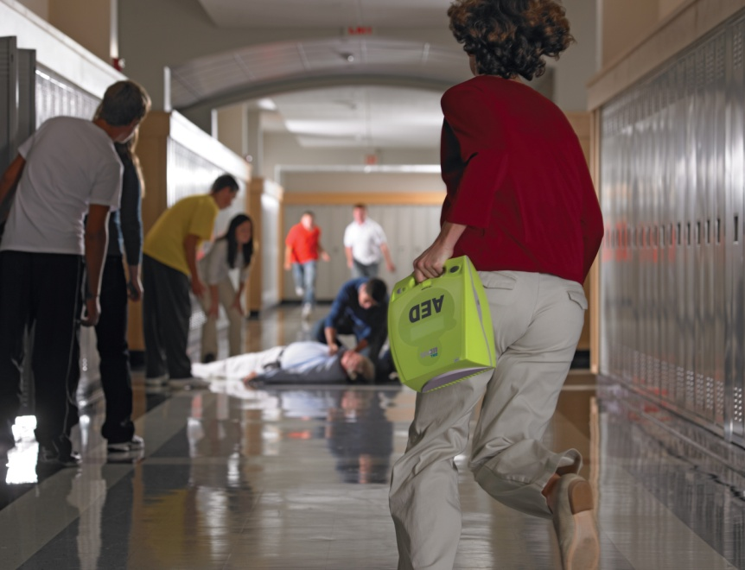
Why Prepare?
Up to 40% of businesses fail following a natural or human-caused disaster
94% of small business owners believe a disaster could seriously disrupt their business within the next two years
Disasters come in many forms: hurricanes, tornados, snow storms, power outages, floods, medical emergency, death of a key employee…
Insurance coverage may not save the day!

Slide 4

Why Prepare?
4 out of 5 businesses fail after the loss of a key executive
One-third of businesses surveyed have no business continuity plan
Here’s the good news: 82% of businesses agree - “If someone could make it easy for me to be prepared, I’d do it.”

Slide 5

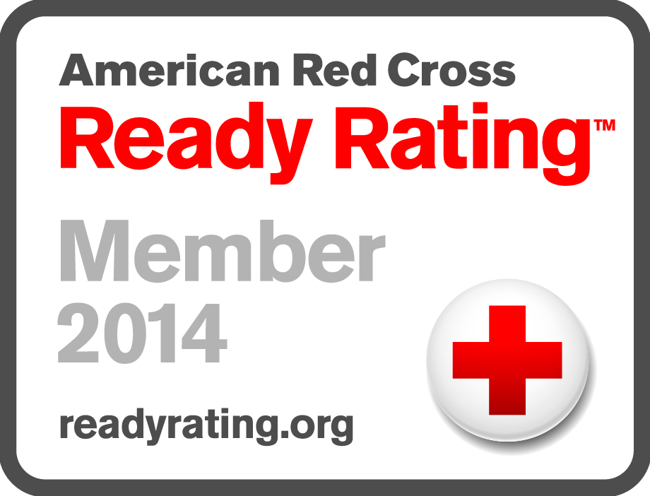
What is Ready Rating?
The Ready Rating Program:
The first emergency readiness program of its kind

Slide 6

Background
Established in 2008 by the St. Louis Red Cross with support of several large businesses.
Focus on mid size and small business to help them measure, diagnose, and improve their level of emergency preparedness
Membership benefits include:
  Two assessment tools
  Two OSHA compliant EAPs
  Access to a library of resources

Slide 7

Program Overview
Designed to allow businesses, schools and organizations to dramatically improve their level of preparedness
Quantifies an organization’s preparedness with a proprietary assessment tool
Generates customized reports with confidential feedback to help members
Enables creation of a customized Emergency Response Plan through an easy, on-line, self-paced tool
Free, thanks to our generous sponsors

Slide 8

Who Are the Members?
Businesses – small to large
Schools – public and private
Non-profits
Healthcare organizations
Financial institutions
Insurance agencies
Retailers
Manufacturers
Houses of worship

Slide 9

Benefits
Program is rich with content and completion of an assessment generates a detailed report that gives specific recommendation on how to improve an existing plan.
Continued attention to these recommendations will help improve the emergency action plan and lead increase the resiliency of the organization.
Management involvement is key to success.
11,818
Ready Rating Members
10172 Bus/Orgs
1,1646 Schools
Notes:
The latest Membership Numbers can be found at http://www.readyrating.org/membershipataglance.aspx

Slide 10
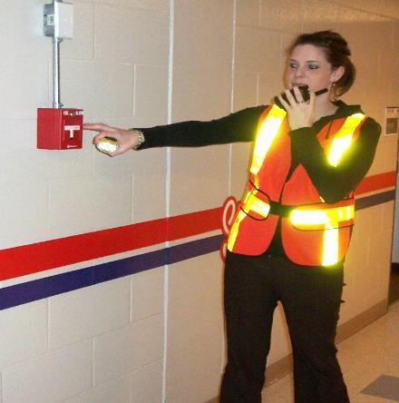
Needed Resources
Support in the form of a Program Manager and other staff support.
Staff volunteers to fill some key roles.
Ongoing training and new employee orientation plan.
Periodic exercises and medical drills.
Updated record keeping including staff contact information.
Periodic review of insurance plans and acquisition of support tools and supplies,
Notes:
The latest Membership Numbers can be found at http://www.readyrating.org/membershipataglance.aspx

Slide 11

Where to Begin
Key steps:
Commit to preparing
  Join the Red Cross Ready Rating program
  Complete an online assessment to determine readiness level
Focus on up to 5 recommendations
Keep management involved
Return to the Ready Rating website periodically to update your profile and assessment score

Slide 12

Other Actions
Share your emergency action plan
with business partners and vendors
  Encourage them to join.
  Help staff members develop a
  household emergency plan
Practice your plan
  Integrate preparedness in your organizational culture
Show your community you care
  Commit to helping your community get prepared

Slide 13
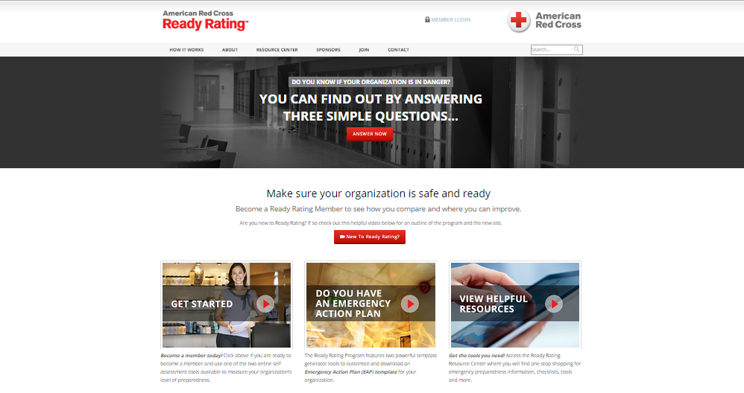
Visit the Site and Explore

Slide 14
Thank you
Notes:
14

